Slide 1

BUCK-BOOST SINGLE PHASE VOLTAGE SOURCE INVERTER FOR DISTRIBUTION GENERATION SYSTEMS
St. ANN’S COLLEGE OF ENGINEERING AND TECHNOLOGY, CHIRALA
DEPARTMENT OF ELECTRICAL & ELECTRONICS ENGINEERING
BATCH: 13
    PROJECT ASSOCIATES
V .SRINIVASA RAO -10F01A02B5
V .SOWJANYA -10F01A02B4
M.PAVAN KUMAR -10F01A0275
K .PRAKASH BABU-11F05A0215
    PROJECT GUIDE:
    Mr.P Ramesh (M.Tech)
    Assistant professor

Slide 2
Contents
Abstract
Introduction
Buck Boost Converter
Single Phase Voltage Source Inverter
Block Diagram Of Buck Boost Voltage Source Inverter
Open Loop Simulation Diagram
Buck Boost Converter Inverter
Conclusion

Slide 3
ABSTRACT:
Inverters of PV system based distributed generators (DG) are often subjected to wide changes in the inverter input voltage, which is either above or below the output ac voltage, thus demanding a buck-boost operation of inverters.
In this paper a single-phase transformer less inverter topology is going to be implemented that can operate over a wide dc input voltage range making it suitable for distributed generation applications.

Slide 4
INTRODUCTION
Distributed generation (DG) systems are usually small modular devices close to electricity consumers. These include wind turbines, solar energy systems, fuel cells, micro gas turbines, and small hydro systems, as well as relevant control and energy storage systems. Such systems normally need inverters as interfaces between their single phase loads and sources as shown in the below Figure 1.

Slide 5
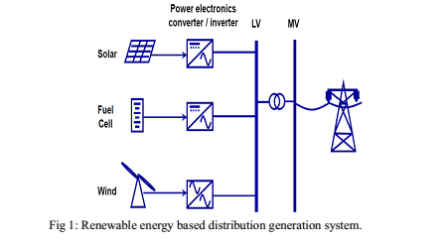

Slide 6
BUCK-BOOST CONVERTERS
Notes:
BUCK-BOOST CONVERTERS

Slide 7
FIGURE 2.5:BUCK-BOOST CONVERTER
Notes:
Basic topology of buck-boost converter

Slide 8
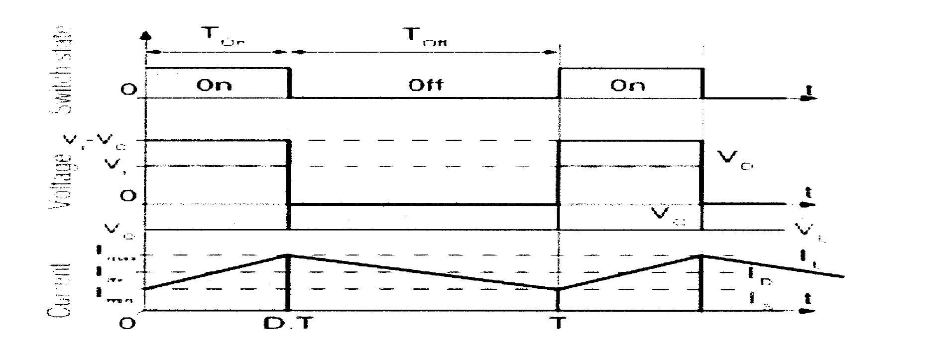
fig3: Current and voltage waveforms of BUCK BOOST converter
Notes:
Current and voltage waveforms of ideal converter

Slide 9
Single phase voltage source inverter
An inverter is basically a device that converts electrical energy of DC form into that of AC
The type of inverter where the independently controlled ac output is a v
oltage waveform. The output voltage waveform is mostly remaining unaffected by the load. Due to this property, the VSI have many industrial applications such as adjustable speed drives (ASD)
Notes:
Single phase voltage source inverter

Slide 10
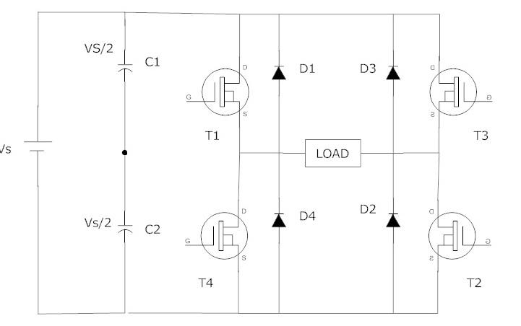
Fig4: SINGLE PHASE FULL BRIDGE I NVERTER
Notes:
SINGLE PHASE FULL BRIDGE INVERTERS

Slide 11
fig5:Block diagram of buck-boost voltage source inverter

Slide 12
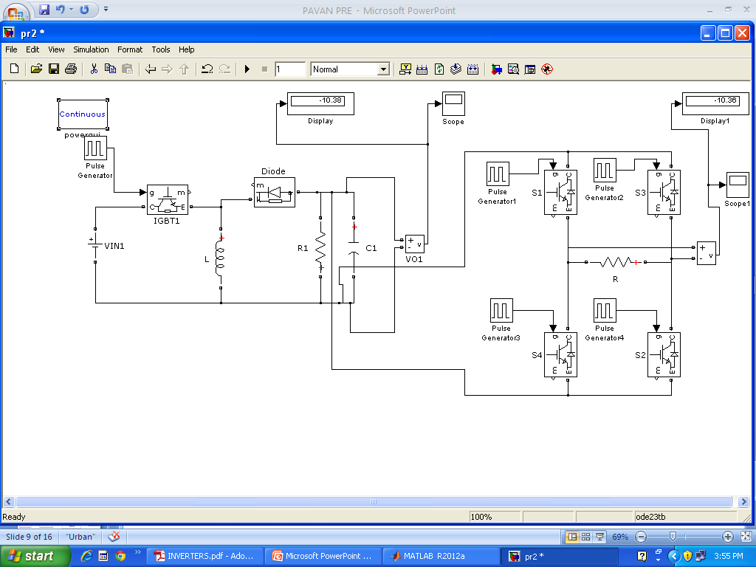
BUCK-BOOST SINGLE PHASE VOLTAGE SOURCE INVERTER SIMULATION DIAGRAM

Slide 13
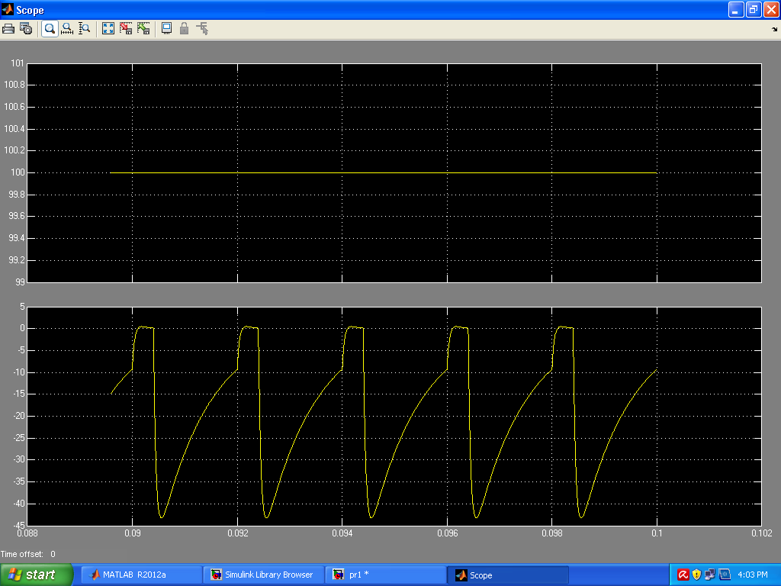
fIg : Input and Output voltage wave forms for Buck operation

Slide 14
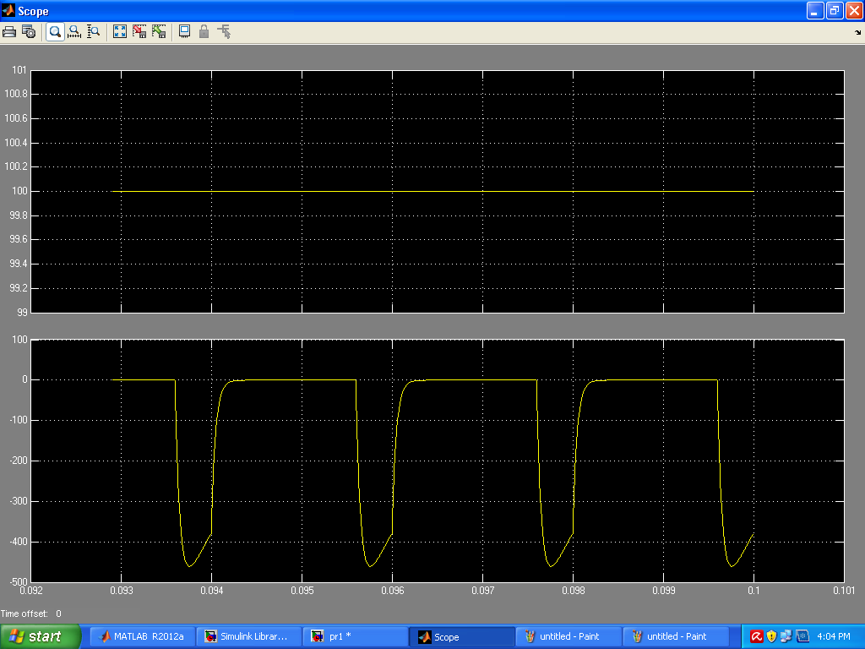
Fig: Input and Output voltage wave forms for Boost operation
Notes:
BUCK BOOST OUTPUT

Slide 15
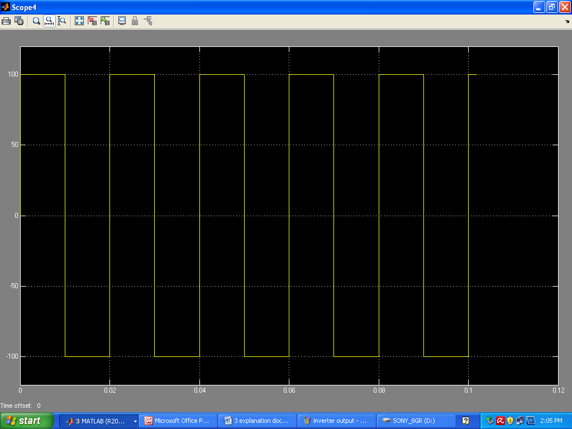
FIG: SINGLE PHASE VOLTAGE SOURCE INVERTER OUTPUT
Notes:
SINGLE PHASE VOLTAGE SOURCE INVERTER OUTPUT

Slide 16
CONCLUSION
Simulation of unidirectional buck- boost single phase voltage source inverter has been carried out using MATLAB simulink software. From the simulation results it is seen that the proposed topology of buck-boost single phase voltage source inverter is producing an ac square wave output depending upon the input to the buck-boost converter.
From the simulation results it is observed that the buck-boost single phase voltage source inverter either bucks or boosts the input voltage.
The proposed inverter is applicable as a utility interactive inverter for distributed generating systems and harmonic elimination applications. The proposed inverter uses six switches. The low switching frequency of the output H-bridge reduces inverter switching losses and costs, compared to six and eight switch-based techniques.
Notes:
conclusion

Slide 17
FUTURE WORK:
Closed loop operation of Buck-Boost single phase VSI for Distribution Generation system

Slide 18
References
“ by Tirtharaja Sen, Pijuh kanti Bhattacharjee and Manjima Bhattacharya.
Power Electronics by M.D.Singh & Dr. K .B. Khanchandani.
Power Electronics by P.S.Bimbra.
Power electronic devices, circuits and applications by Muhammad H. Rashid, Prentice Hall of India Publishers Ltd, 2009.
Fundamentals of Electrical Drives by G.K. Dubey.
P.C. Sen., Modern Power Electronics, Wheeler Publishing, 1998.

Slide 19


Slide 20
QUESTION TIME ?

